Slide 1


Gandhi Institute of Science and Technology Kholiguda,Rayagada,odisha Seminar : NanoTechnology
Kothakota Aaksshay Kumandan
Branch :CSE B.Tech Final Year
Regd No :1901317069

Slide 2
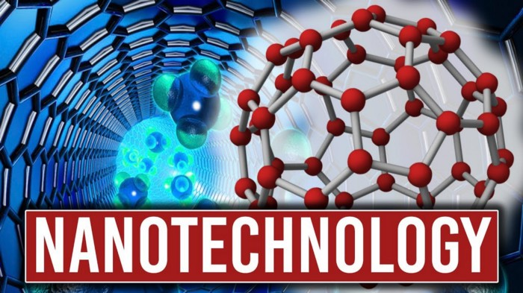

Slide 3

What is Nano and Technology
A Nanometer is a unit of length in the metric system ,equal to one billion of a metre(10^-9)
Technology is the making ,usage and knowledge of tools ,machines and techniques ,in order to solve a problem or perform a specific function.

Slide 4

Definition
Nanotechnology is the study of manipulating matter on an atomic scale.
Nanotechnology refers to the constructing and engineering of the functional systems at very micro level or we can say at atomic level.
A Nanometer is one billion of a meter , roughly the width of three or four atoms .The average human hair is about 25,000 nanometers wide.

Slide 5
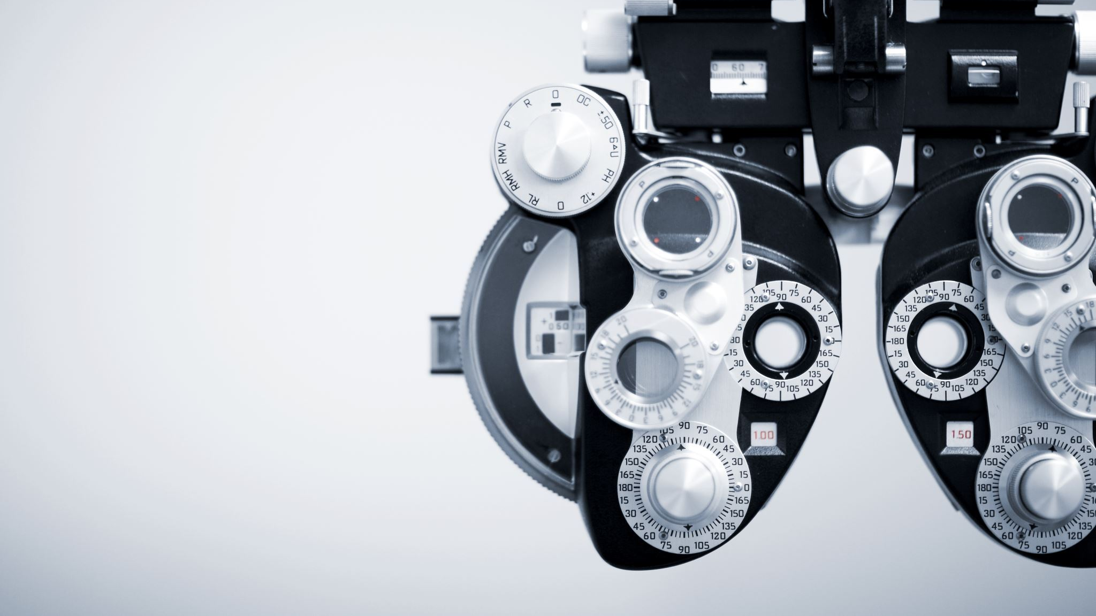
History
The 1st ever concept was presented in 1959 by the famous professor of Dr. Richard P.Feynman.
Invention of the scanning tunneling microscope in 1981 and the discovery of fullerance and the (c6o) in the nano technology.
The term "Nano-technology" had been coined by Norio Taniguchi in 1974.

Slide 6
The early 2000s also saw the beginnings of commercial applications of nanotechnology , although these were limited to bulk applications of nanomaterials.
Silver nano platform for using sliver-nanoparticles as an antibacterial agent .
Nanoparticle - based transparent sunscreens ,and carbon nanotubes for stain - resistant textiles.

Slide 7
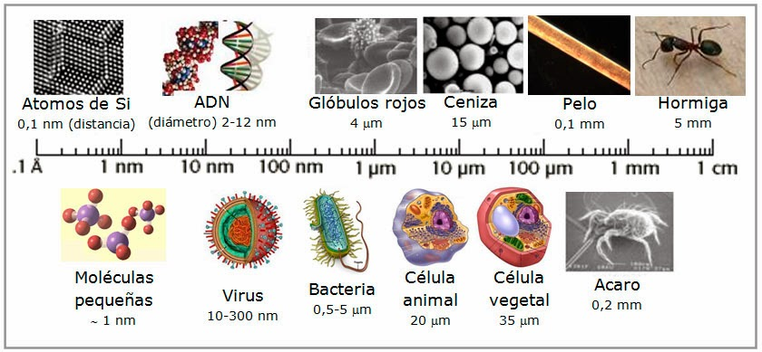

Slide 8
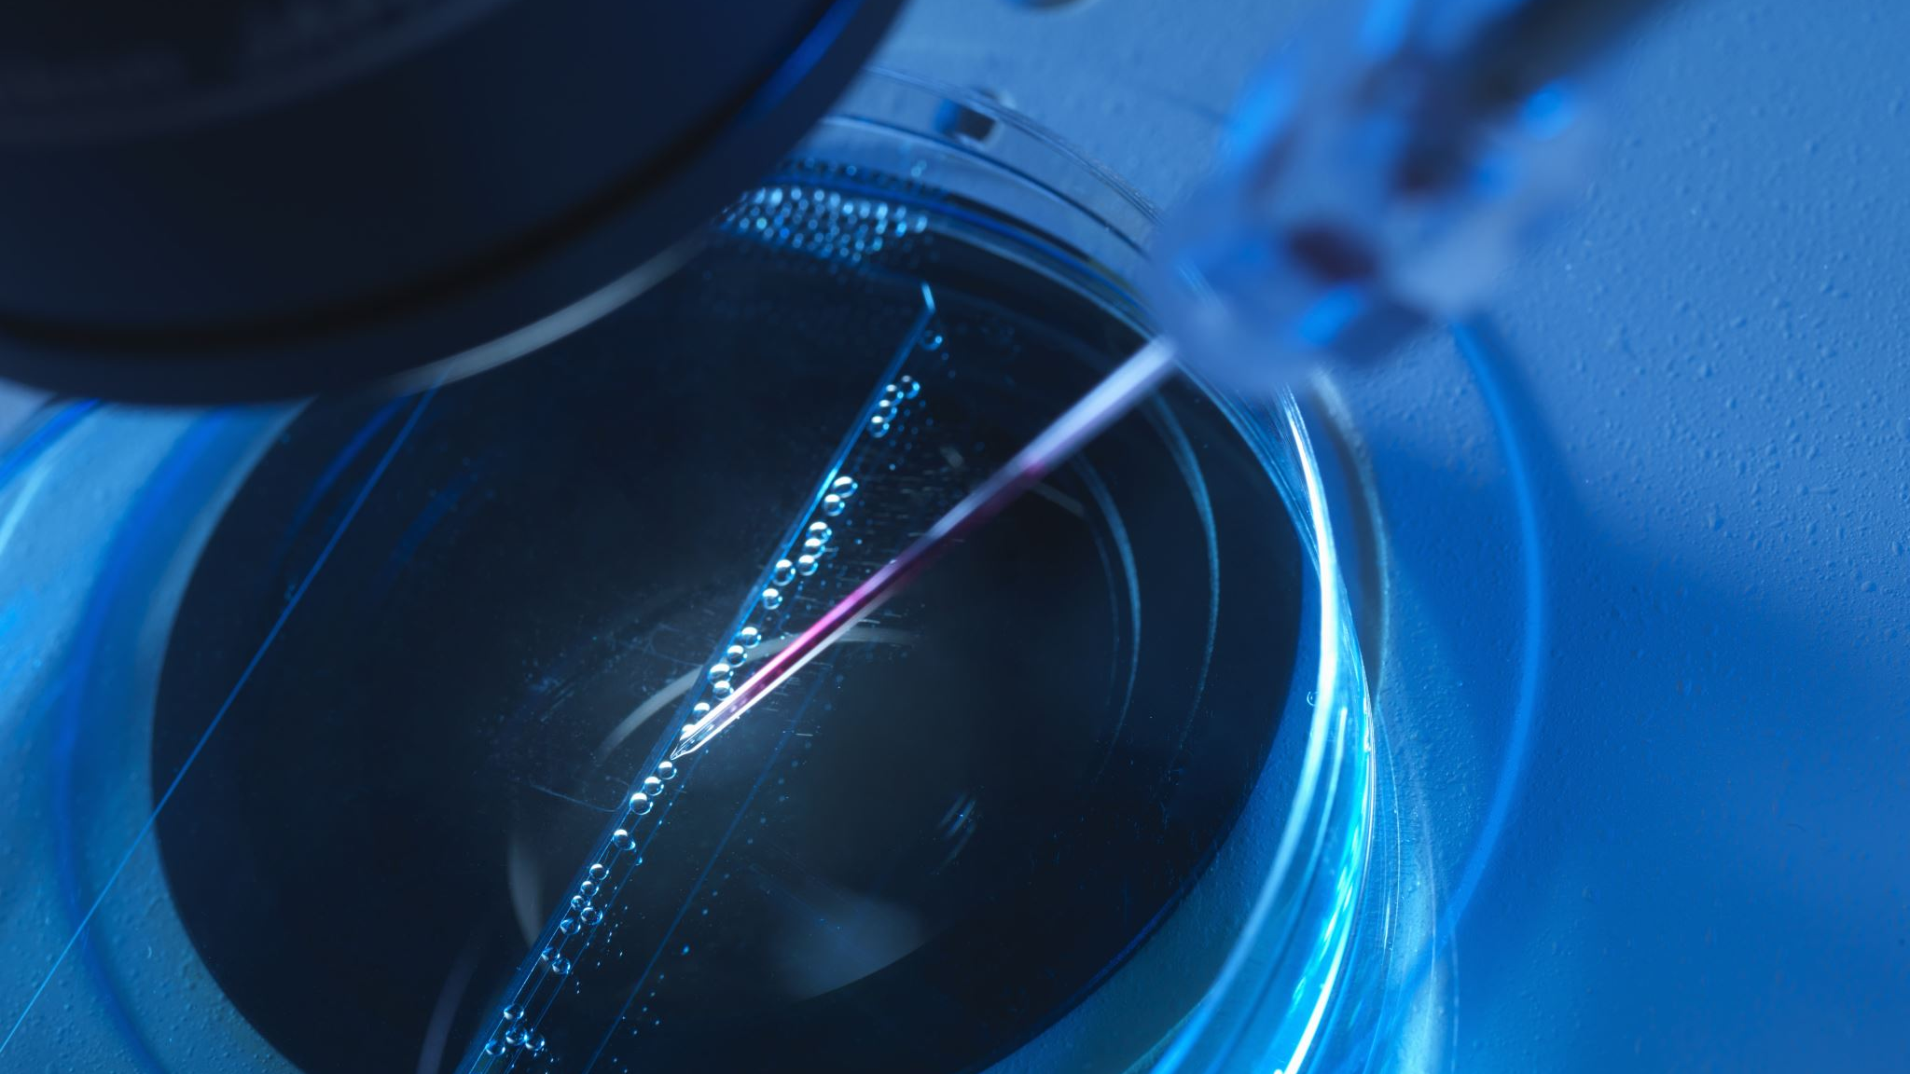
Tools And Technology
There are serval important modern developments.
The atomic force microscope(AFM).
The Scanning Tunneling Microscope (STM) are scanning probes that launched nanotechnology.
Various techniques of nanolithography
Optical Lithography
X- Ray Lithography
Dip pen nanolithography

Slide 9
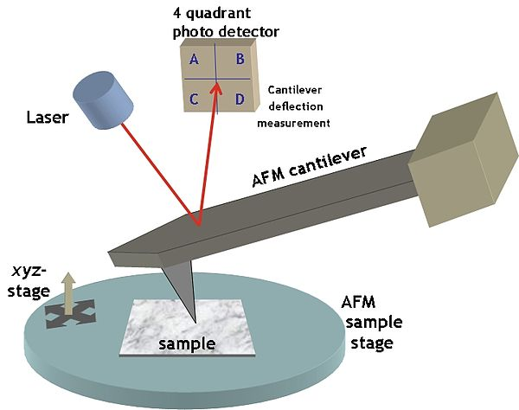
Electron beam lithography(inkjet printer) was developed.
Lithography is typical the transfer of pattern into photosensitive material by selective exposure to a radiation source such as light.

Slide 10
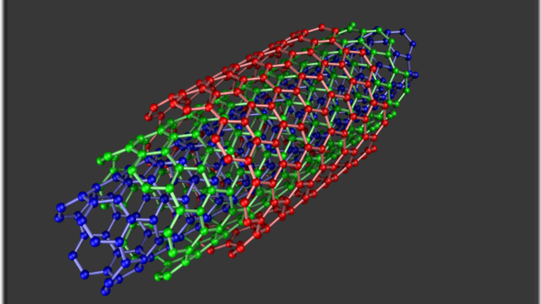
Carbon Nanotube
Carbon nanotubes are allotropes of carbon with a cylindrical nanostructure.
They have length –to-diameter ratio of up to 132,000,000:1
Nanotubes are members of the fullerene structure family.
Their name is derived from their long ,hallow structure with walls formed by one-atom thick sheets of carbon , known as graphene.

Slide 11
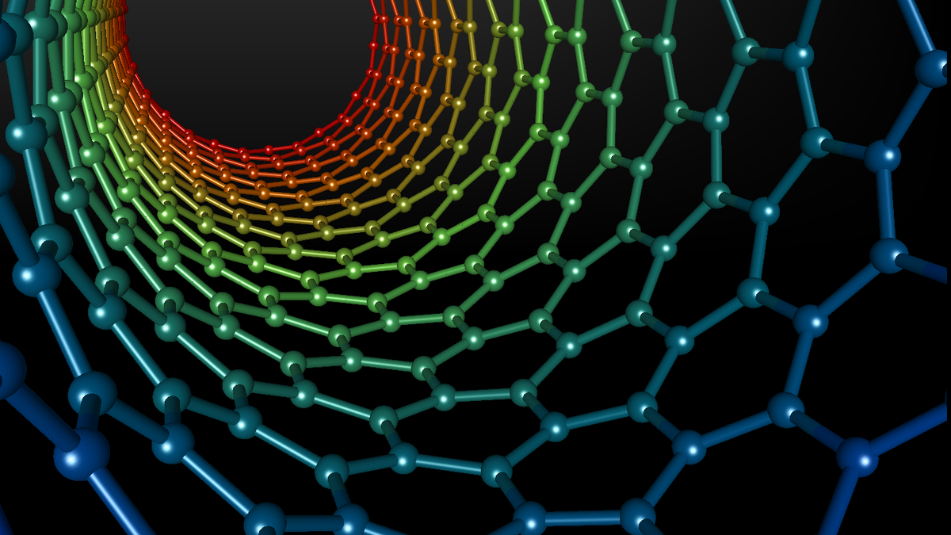
Properties of Carbon Nanotube
Highest strength to weight ratio ,helps in creating light weight spacecrafts.
Easily penetrate membranes such as cell walls ,it helps in cancer treatment.
Electrical Resistance changes significantly when other molecules attach themselves to the carbon atoms.
It helps in developing sensors that can detect chemical vapours.

Slide 12
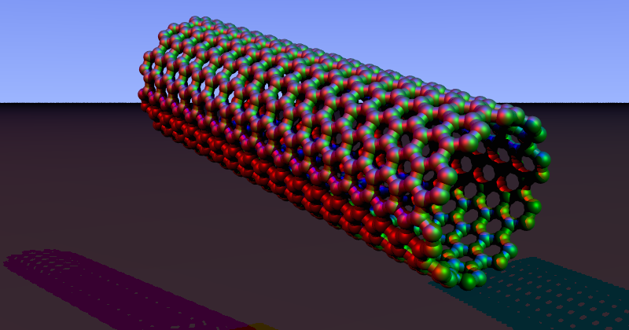
Applications Of Carbon Nano Tubes
Easton –Bell Sports ,Inc. using CNT in making bicycle component.
Zyvex Technologies using CNT manufacturing of light weight boats.
Replacing transistors from the silicon chips as they are small & emit less heat.
In electric cables & wires.
In solar cells
In Fabrics

Slide 13
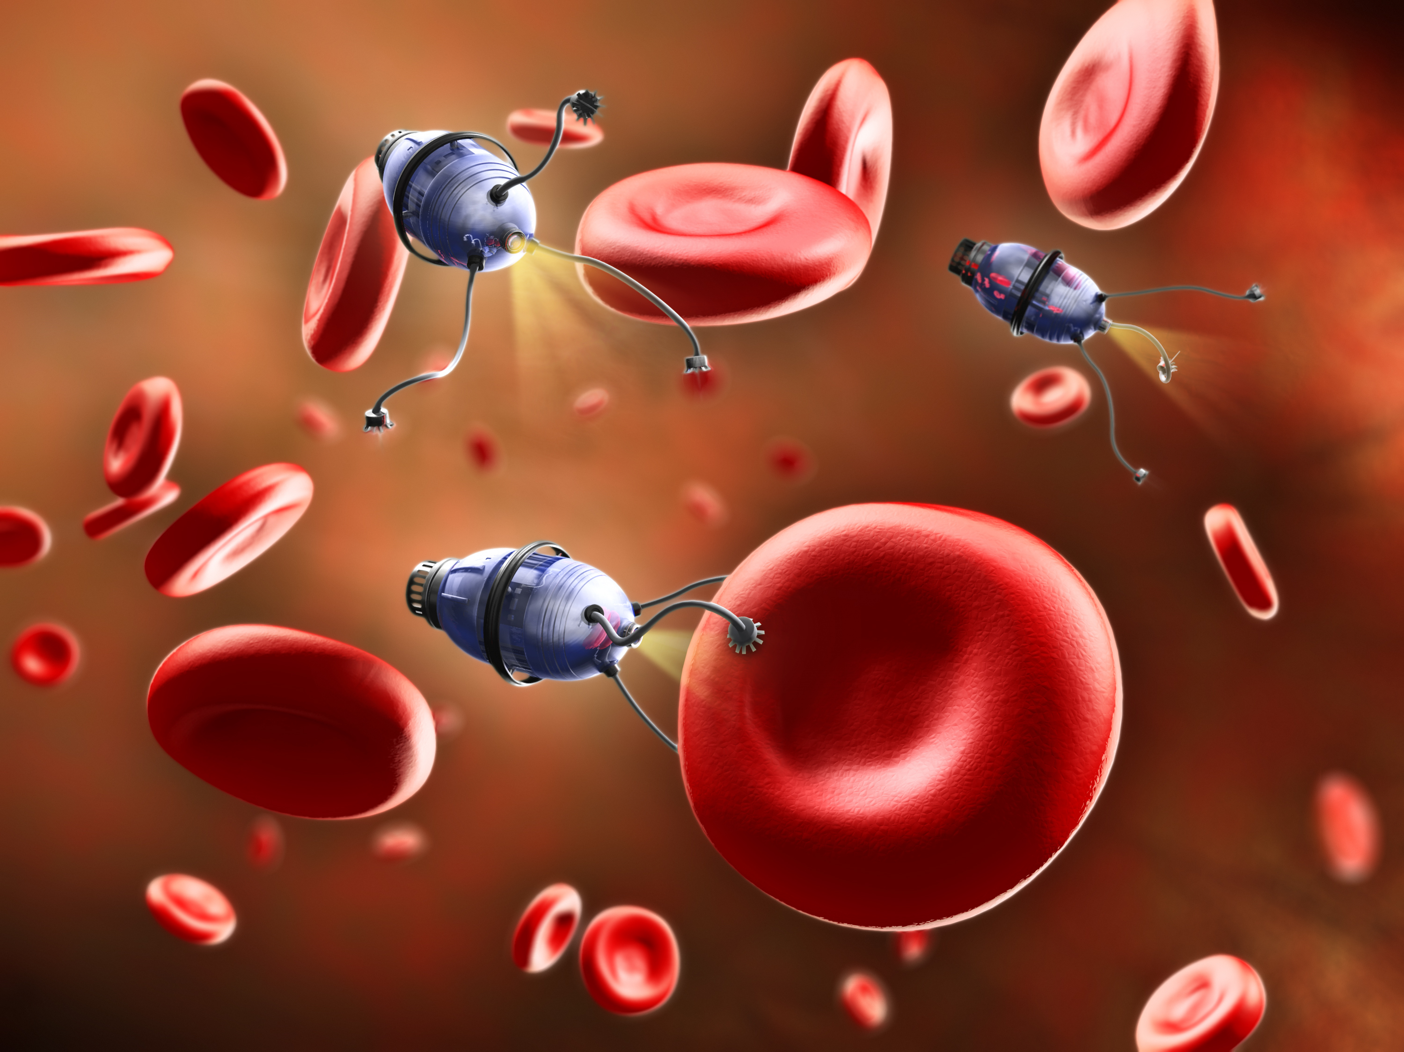
Nanobots
Close to the scale of 10^-9.
Largely in R &d phase.
Nanobots of 1.5 nanometers across ,capable of counting specific molecules in a chemical sample.
Since nanorobots would be microscopic in size, it would probably be necessary for very large numbers of them to work together to perform microscopic & macroscopic tasks.
Capable of replication using environmental resources.

Slide 14

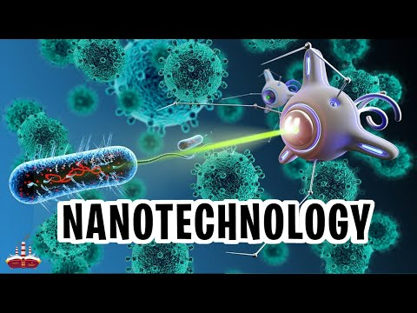




Slide 15
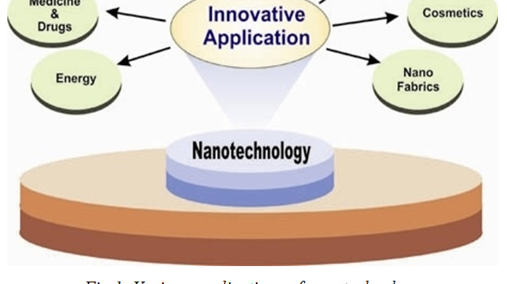
Applications Of Nanotechnology

Slide 16
Nano Technology in Drugs(Cancer)
Provide new option for drug delivery & drug therapies.
Enable drugs to be delivered to precisely the right location in the body &release drug does on a predetermined schedule for optimal treatment.
Attach the drug to a nanosized carrier.
Nanobots can clear the blockage in arteries.
They release the medicine that kills the tumour.
Current treatment is through radiotherapy or chemotherapy.

Slide 17
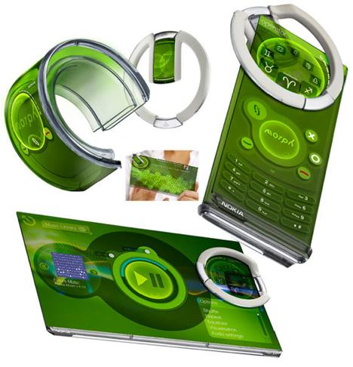
NANO Technology in Mobiles
A nanotechnology concept device developed by Nokia Research Center (NRC) & the University of Cambridge(UK).
Nanoscale electronics also allow stretching.
Nokia envisage that a nanoscale mesh of fibers will allow our mobiles devices to be bent ,stretched & folded into any number of conceivable shapes.

Slide 18
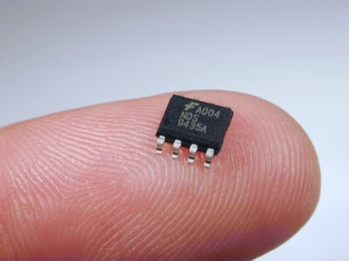
NANO TECHNOLOGY IN ELECTRONICS
Electrodes made from nanowires enable flat panel displays to be flexible as well as thinner than current flat panel displays.
Nanolithography is used for fabrication of chips.
The transistors are made of nanowires ,that are assembled on glass or thin films of flexible plastic.
E- paper ,displays on sunglasses & map on car windshields.
T

Slide 19

NANO TECHNOLOGY IN COMPUTERS
The silicon transistors in your computer may be replaced by transistors based on carbon nanotubes.
Nanorods is a upcoming technology in the display techniques due to less consumption of electricity & less heat emission.
Size of the microprocessor are reduced to greater extend.
By reducing the diameter of the nanowires, researchers believe memristor memory chips can achieve higher memory density than flash memory chips.

Slide 20
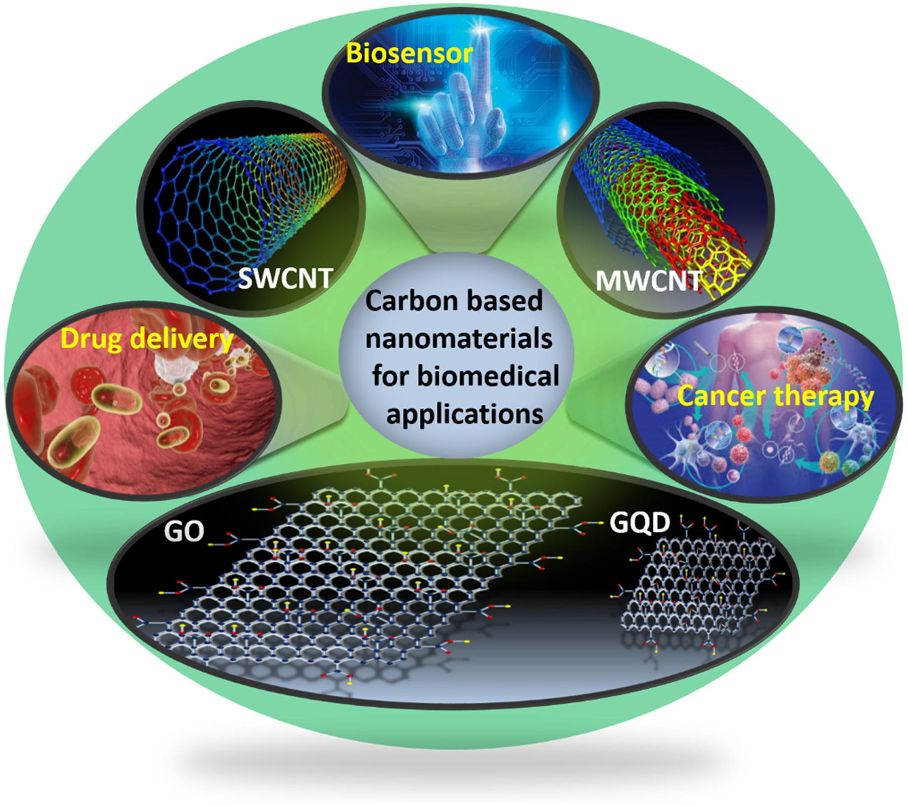
Advantages of using Carbon Nanotubes
Faster and smaller – Carbon nanotubes can be used to produce smaller & faster components.
High speed & high capacity memory.
Allows circuits to be more accurate on the atomic level.

Slide 21

Nano Technology In India
IIT Mumbai is the premier organization in the field of nanotechnology.
Starting in 2001 the Government of India launched the Nano Science & Technology Initiative (NSIT).
The Main objectives of the Nano Mission are
Basic research promotion
Infrastructure development for carrying out front –ranking research.
Human resource development & international collaborations.

Slide 22

Possibilities for the Future
Doctors inside your body Wearable fitness technology means we can monitor our health by strapping gadgets to ourselves.
2. Sensors, sensors, everywhere These sensors rely on newly-invented nanomaterials and manufacturing techniques to make them smaller, more complex and more energy efficient.
3. Self-healing structures .
4. Making big data possible .
5. Tackling climate change .

Slide 23


